Slide 1
COVID-19 Detection Using X-ray

Slide 2
Project Outline
배경: COVID-19 감염 시, 폐에 염증이 발생하는 증상이 있으며, 이는 X-ray/CT 상으로 확인할 수 있음
목표: 폐 사진을 통하여, COVID-19 여부를 판단(이진분류)
Study scope: 모델 자체가 어려운 편은 아니므로, 코드 리뷰하며 딥러닝 스터디 했던 내용을 복습
모델 별 성능:
CNN_kaggle: 86%
VGG16 100% > 전체 데이터셋의 크기가 작아, 정확도가 높게 측정된 경향이 있으나, 일반적인 CNN 대비 VGG16을 사용한 transfer learning의 성능이 좋다는 것은 확실
프로젝트 한계 : COVID-19 이외에도 폐에 염증을 일으킬 수 있는 질환이 많으므로, X-ray만으로 양성 여부를 판단하기 어려움.
Notes:
Think of your respiratory tract as an upside-down tree. The trunk is your trachea, or windpipe. It splits into smaller and smaller branches in your lungs. At the end of each branch are tiny air sacs called alveoli. This is where oxygen goes into your blood and carbon dioxide comes out.
The new coronavirus can infect the upper or lower part of your respiratory tract. It travels down your airways. The lining can become irritated and inflamed. In some cases, the infection can reach all the way down into your alveoli.
COVID-19 is a new condition, and scientists are learning more every day about what it can do to your lungs. They believe that the effects on your body are similar to those of two other coronavirus diseases, severe acute respiratory syndrome (SARS) and Middle East respiratory syndrome (MERS)
Doctors can see signs of respiratory inflammation on a chest X-ray or CT scan. On a chest CT, they may see something they call “ground-glass opacity” because it looks like the frosted glass on a shower door.
-----------------------
Nature
We use high parameter imaging mass cytometry⁹ targeting the expression of 36 proteins, to investigate at single cell resolution, the cellular composition and spatial architecture of human acute lung injury including SARS-CoV-2. This spatially resolved, single-cell data unravels the disordered structure of the infected and injured lung alongside the distribution of extensive immune infiltration.
Neutrophil and macrophage infiltration are hallmarks of bacterial pneumonia and COVID-19, respectively. We provide evidence that SARS-CoV-2 infects predominantly alveolar epithelial cells and induces a localized hyper-inflammatory cell state associated with lung damage.

Slide 3
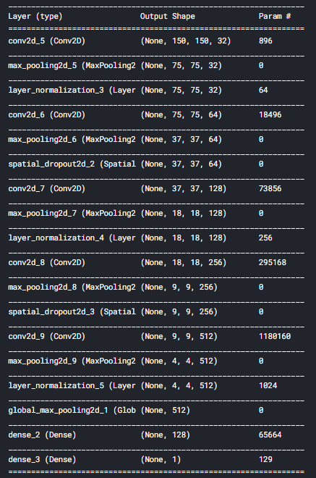
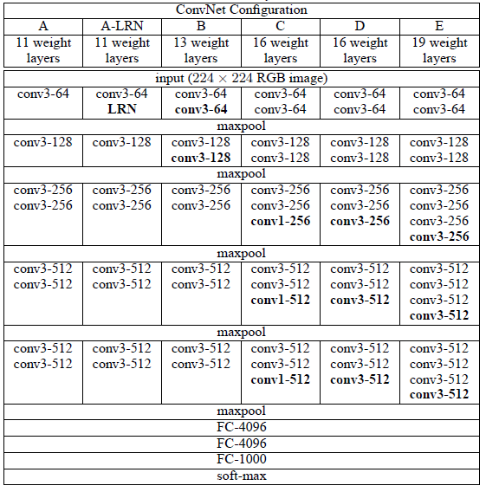
Model layout
Filter size
Kaggle Model
VGG16

Slide 4
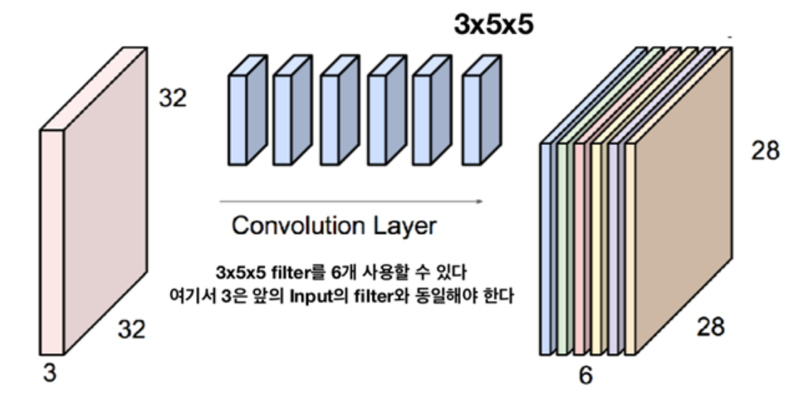
1. Convolution
tf.keras.layers.Conv2D(filters = 32, kernel_size = (3,3), strides = (1,1), padding='same', activation='relu’)
1) What is filter and kernel?
channel
kernel_size
channel
filters
Notes:
Filter: 하나의 feature를 뽑아내는 단위

Slide 5
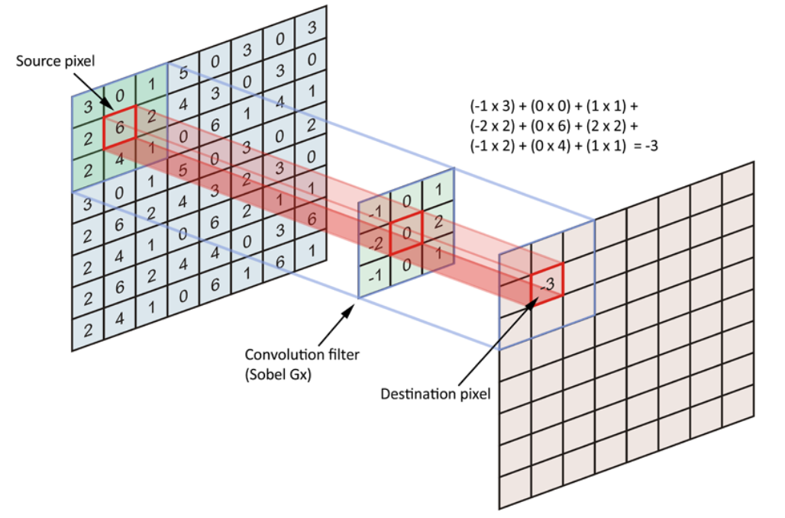
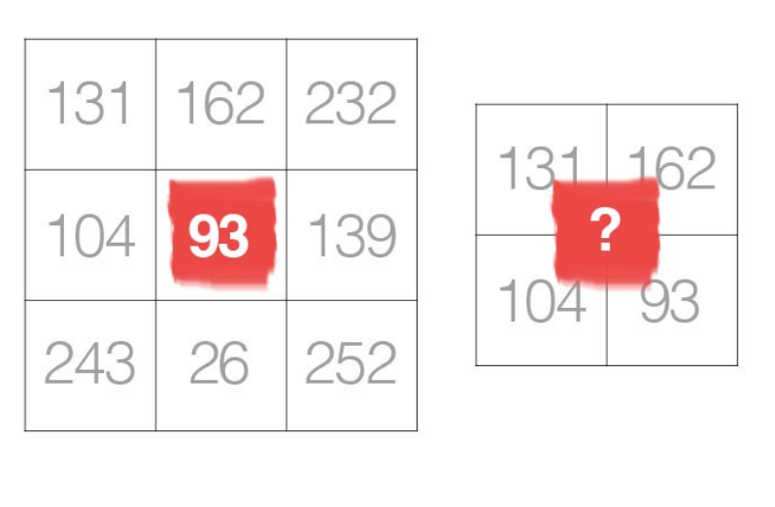
1. Convolution
tf.keras.layers.Conv2D(filters = 32, kernel_size = (3,3), strides = (1,1), padding='same', activation='relu’)
2) Deciding Optimal Kernel for CNN
smaller kernel sizes are and should be a popular choice over larger sizes
a preference for odd number as kernel size over a 2x2 or 4x4 kernel size
> kernel_size = (3,3) is popular

Slide 6
2. Pooling tf.keras.layers.MaxPool2D(pool_size=(2,2)) & tf.keras.layers.GlobalMaxPool2D()
Difference btw MaxPool2D and GlobalMaxPool
tf.keras.layers.MaxPool2D(pool_size=(2, 2), strides=None, padding='valid’, data_format=None, **kwargs)
Output shape:
If data_format='channels_last’: (batch_size, pooled_rows, pooled_cols, channels)
If data_format='channels_first’: (batch_size, channels, pooled_rows, pooled_cols)
tf.keras.layers.GlobalMaxPool2D(pool_size=(2, 2), strides=None, padding='valid’, data_format=None, **kwargs)
Output shape:
2D tensor with shape (batch_size, channels).
Notes:
Output shape:
If data_format='channels_last': 4D tensor with shape (batch_size, pooled_rows, pooled_cols, channels).
If data_format='channels_first': 4D tensor with shape (batch_size, channels, pooled_rows, pooled_cols).
Global max pooling operation for spatial data.
Output shape:
2D tensor with shape (batch_size, channels).

Slide 7
3. Preventing Overfitting tf.keras.layers.SpatialDropout2D(0.20)
What is SpatialDropout2D for?
necessary for control overfitting
Especially, size of input image being small, risk or overfitting was high
SpartialDropout2D
same function as Dropout but drops entire 2D feature maps instead of individual elements.
If adjacent pixels within feature maps are strongly correlated (as is normally the case in early convolution layers) then regular dropout will not regularize the activations and will otherwise just result in an effective learning rate decrease. In this case, SpatialDropout2D will help promote independence between feature maps and should be used instead.
Notes:
it seems that in Spatial Dropout, we randomly set entire feature maps (also known as channels) to 0, rather than individual 'pixels.’
that regular dropout would not work so well on images because adjacent pixels are highly correlated. So if you hide pixels randomly I can still have a good idea of what they were by just looking at the adjacent pixels. Dropping out entire feature maps might be better aligned with the original intention of dropout.

Slide 8
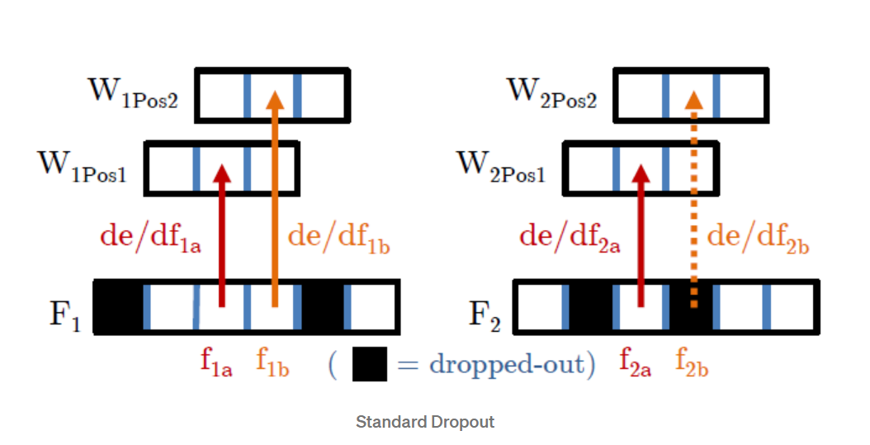
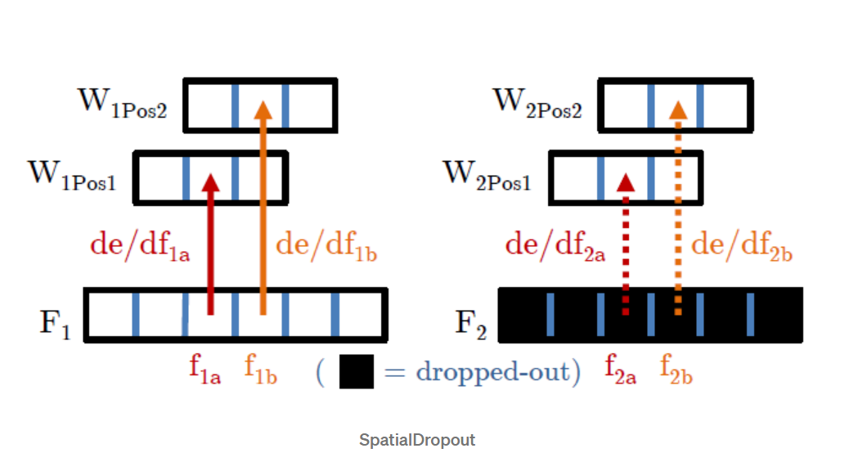
3. Preventing Overfitting tf.keras.layers.SpatialDropout2D(0.20)
SpartialDropout2D
Notes:
it seems that in Spatial Dropout, we randomly set entire feature maps (also known as channels) to 0, rather than individual 'pixels.’
that regular dropout would not work so well on images because adjacent pixels are highly correlated. So if you hide pixels randomly I can still have a good idea of what they were by just looking at the adjacent pixels. Dropping out entire feature maps might be better aligned with the original intention of dropout.
adjacent pixels in the dropped-out feature map are either all 0 (dropped-out) or all active, just like at the right of the above figure.

Slide 9
Optimizer Normalization Data Augmentation Transfer Learning

Slide 10
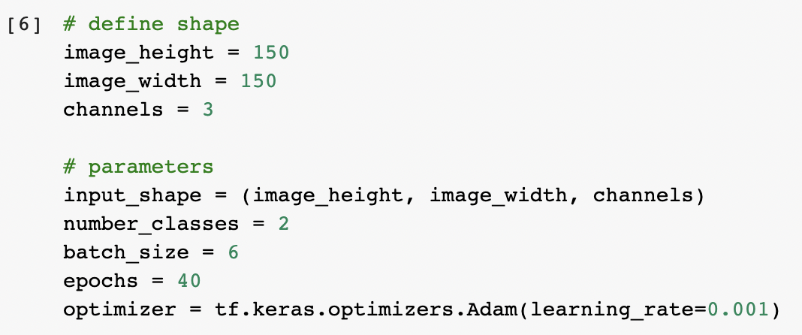
Optimizer

Slide 11
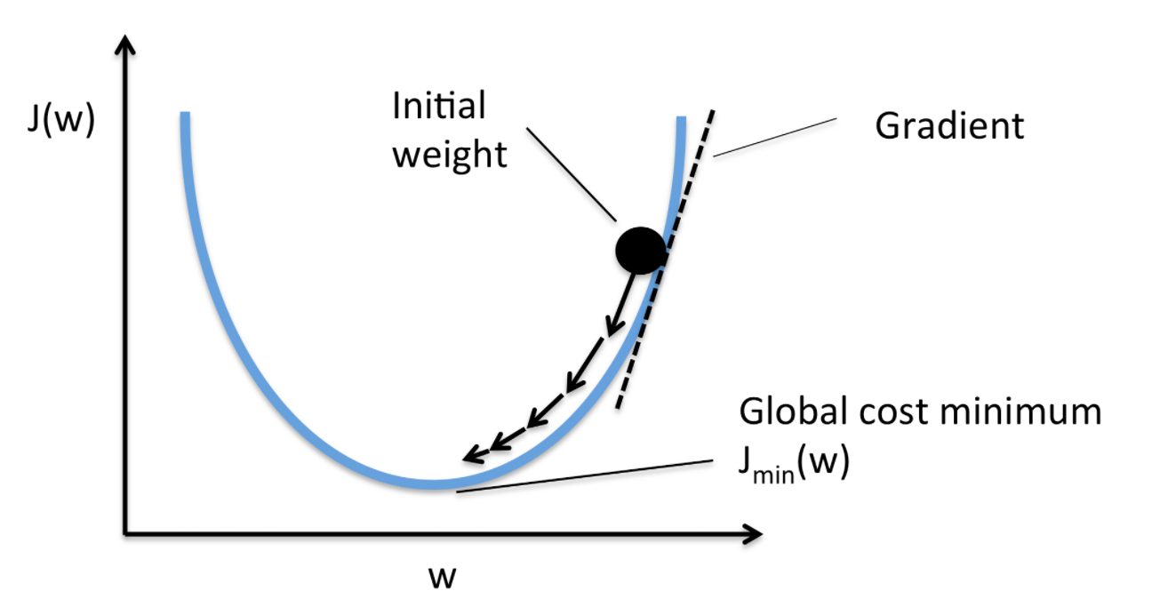

Optimizer
Optimization : 손실 함수의 값을 가능한 낮추는 Hyperparameters 찾기
Optimizer : 머신러닝 학습 프로세스에서 실제로 파라미터를 갱신시키는 부분

Slide 12
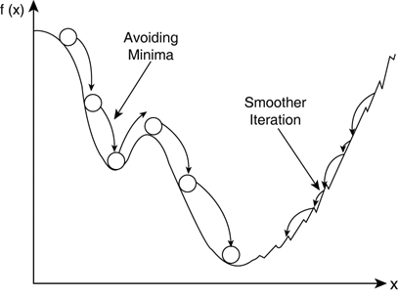
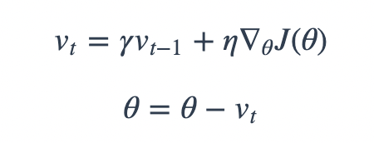
SGD + Momentum
Gradient Descent 통해 이동하는 과정에 일종의 ‘관성’을 주는 것
기존 SGD 방식을 이용할 때, 빠질 수 있는 Local Minima 빠져 나올 수 있다

Slide 13
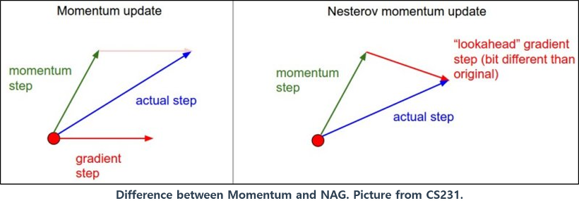
Nesterov Accelerated Gradient (NAG)
최적의 파라미터를 관성에 의해 지나칠 수 있는 기존의 문제 해결

Slide 14
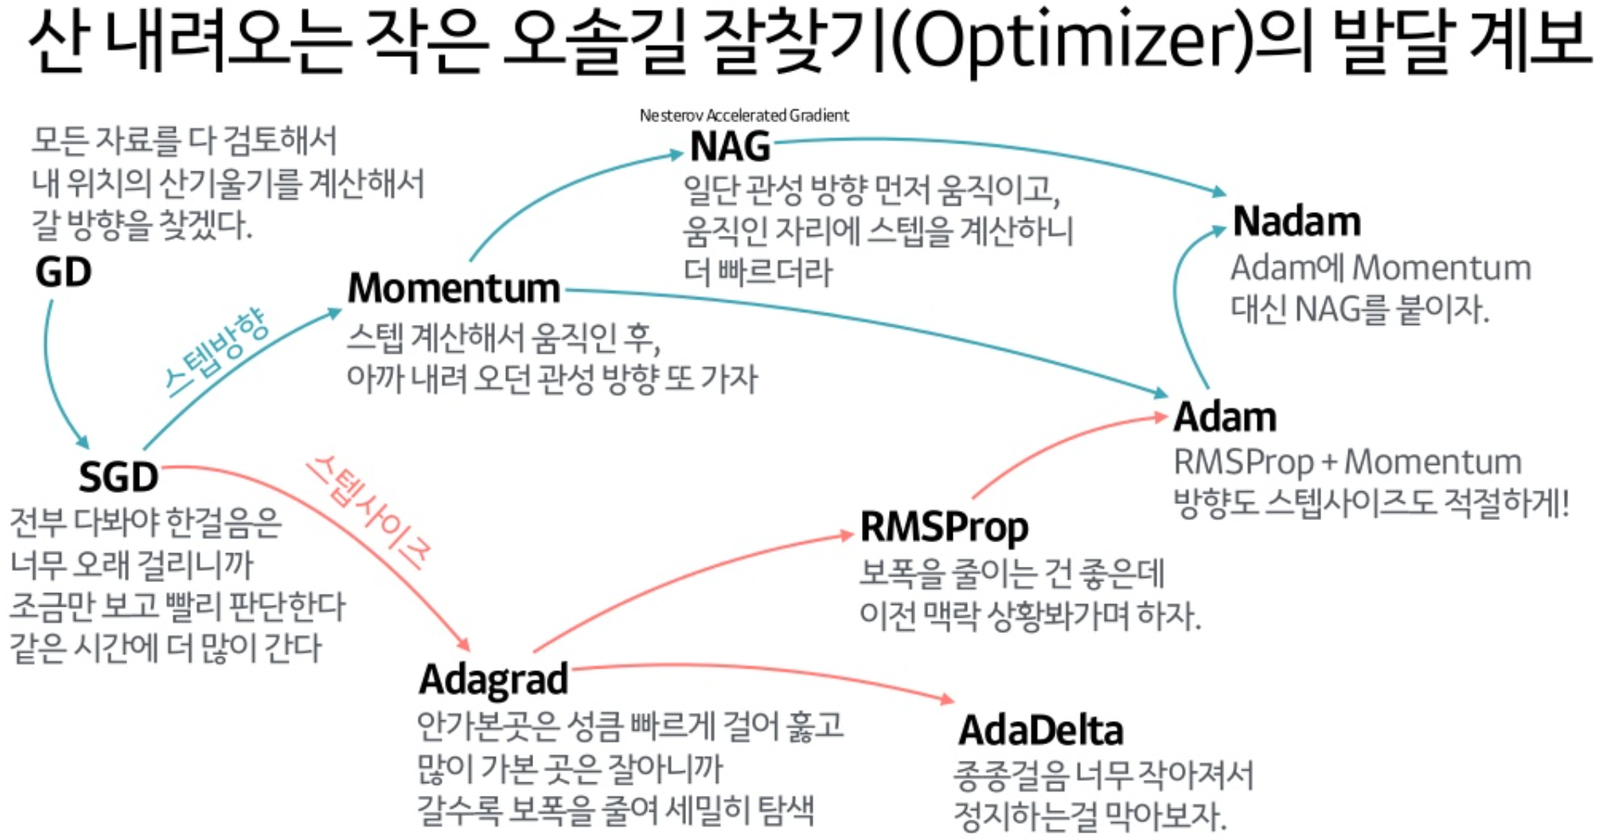
Optimizer

Slide 15
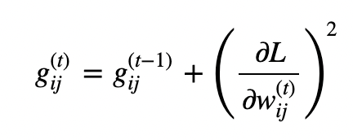
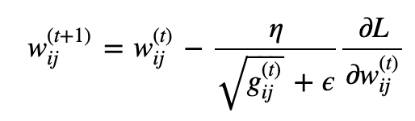
Adaptive Gradient (AdaGrad)
고정된 Learning Rate가 아니라 각각의 변수마다 적합한 Learning Rate 설정
변화가 많았던 변수들은 lr 작게, 변화가 적었던 변수들은 lr 크게

Slide 16
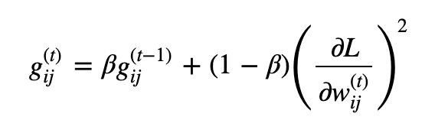
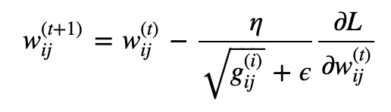
Root Mean Square Propagation (RMSprop)
Gradient 제곱의 합이 아닌 Gradient 제곱의 지수 이동 평균 이용

Slide 17
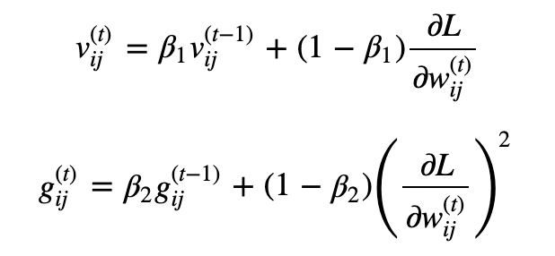
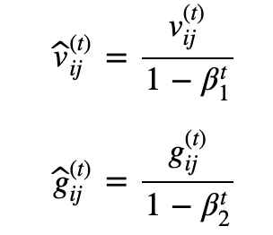
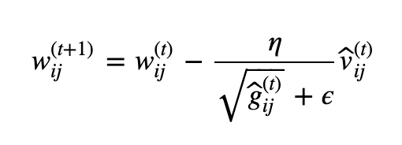
Adaptive Momentum Estimation (Adam)
Deep Neural Network 학습에 가장 광범위하게 이용되고 있는 알고리즘
Momentum + RMSprop

Slide 18
Optimizer

Slide 19
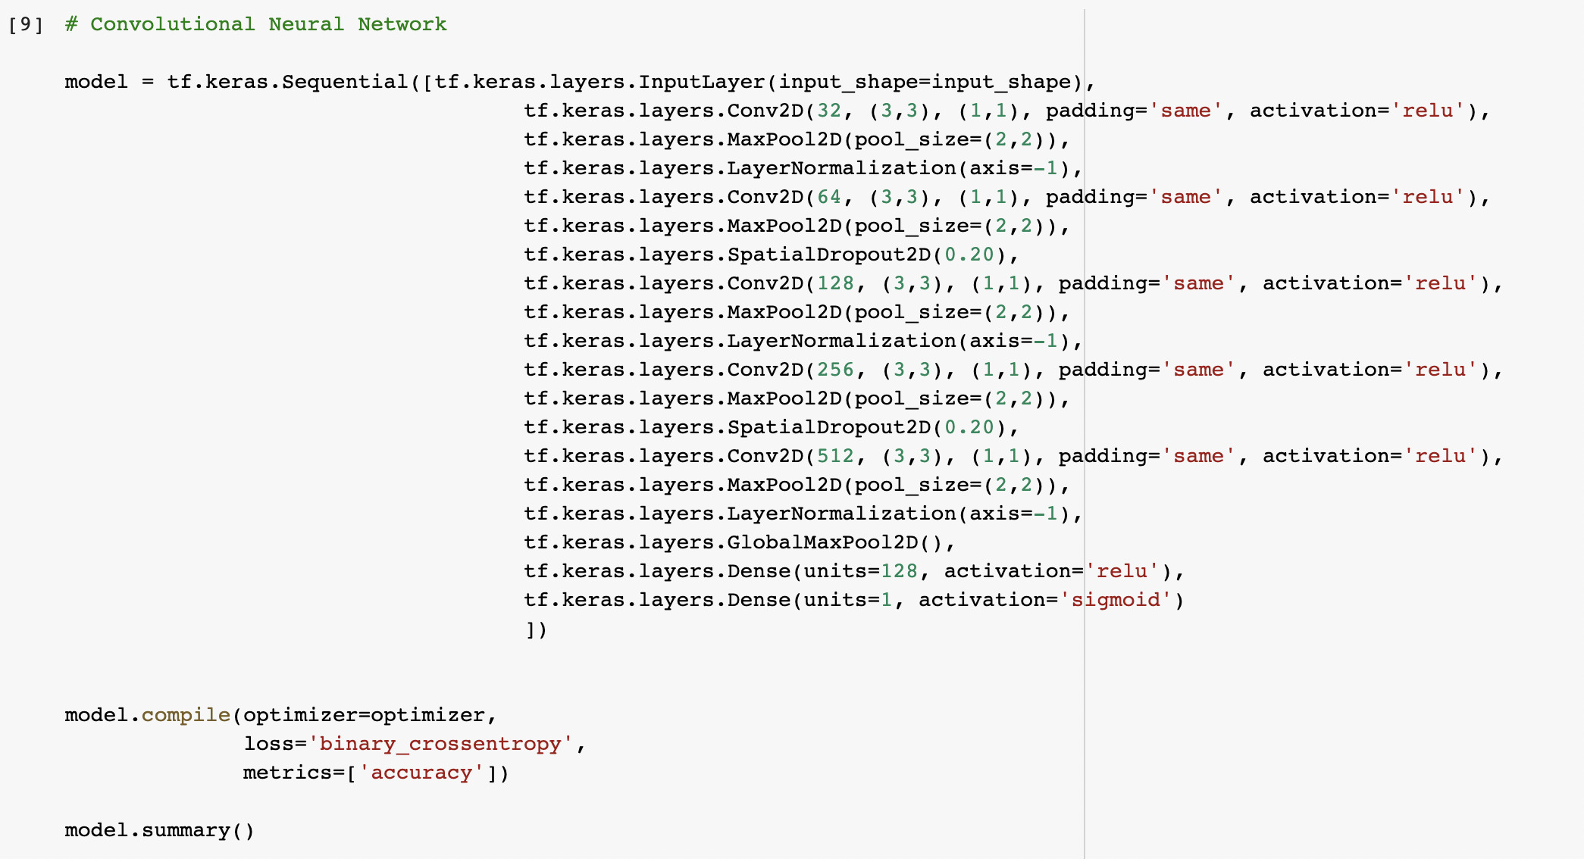

Slide 20
Batch Normalization vs Layer Normalization
Normalization : 값 범위의 차이를 왜곡시키지 않고 데이터를 공통 스케일로 변경
<Batch Normalization>
Batch 단위로 각 Feature의 평균을 구한다.
각 데이터들의 분산을 구한다
Normalize
Scale & Shift
< Layer Normalization>
Batch 차원에서 정규화가 이루어지지 않고
각 Feature에 대한 계산이 독립적으로 이루어진다.

Slide 21
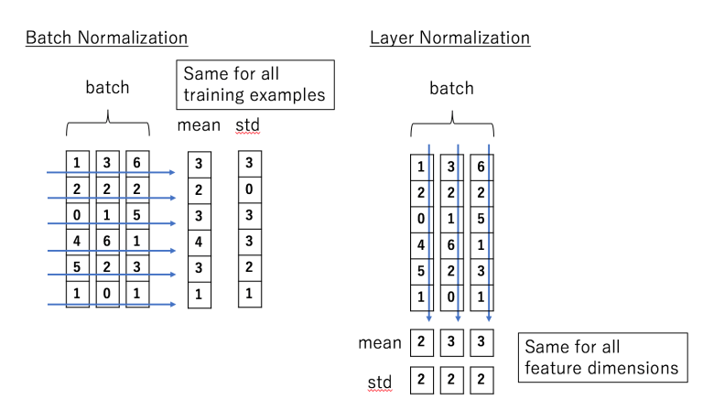
Batch Normalization vs Layer Normalization

Slide 22
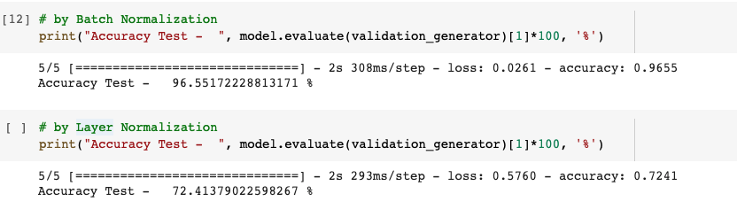
Normalization

Slide 23
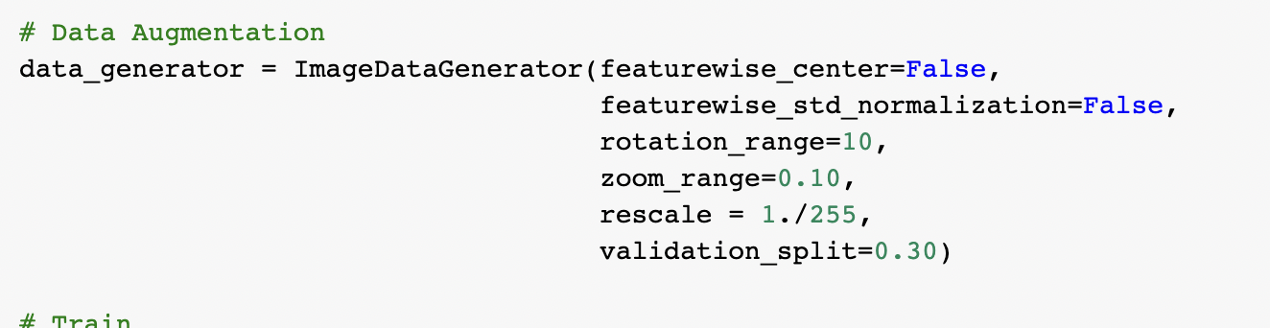
Data Augmentation

Slide 24
Data Augmentation
rotation_range = 이미지 회전 범위 (degrees)
width_shift, height_shigt : 그림을 수평 또는 수직으로 랜덤하게 평행이동시키는 범위 (원본 가로, 세로 길이에 대한 비율 값)
Rescale : 원본 이미지는 0~255이므로 1/255로 스케일링 0~1 범위로 변환시켜준다. 이는 다른 전처리 과정에 앞서 가장 먼저 적용
shear_range : 임의 전단 변환 범위 (shearing transformation)
zoom_range : 임의 확대 / 축소 범위
horizontal_flip : True로 설정하면 50%의 확률로 이미지를 수평으로 뒤집는다.

Slide 25
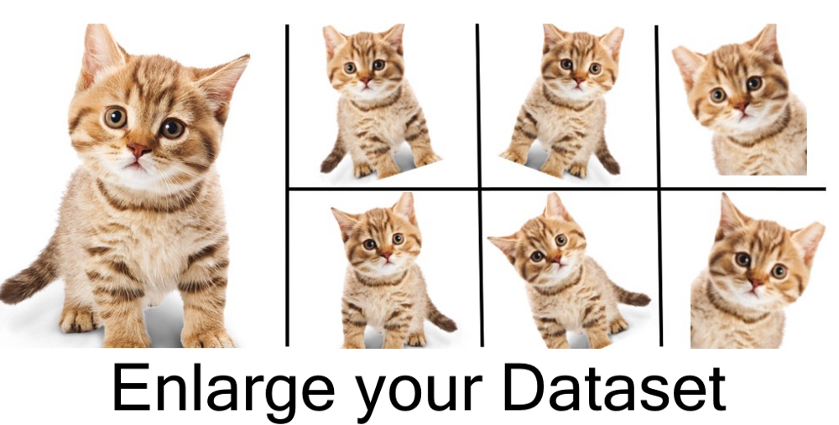
Data Augmentation

Slide 26

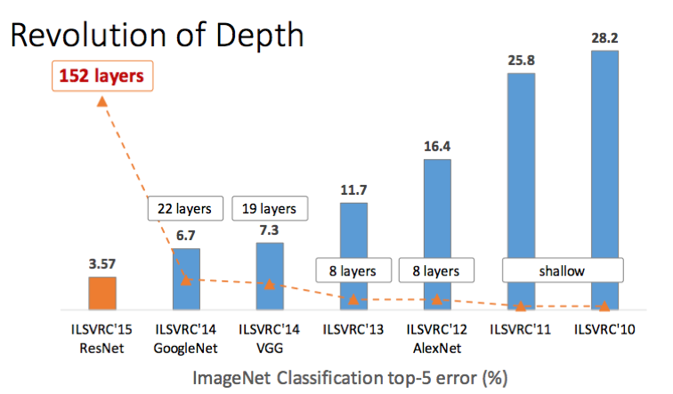
+ Transfer Learning & Fine Tuning (VGG-16)

Slide 27
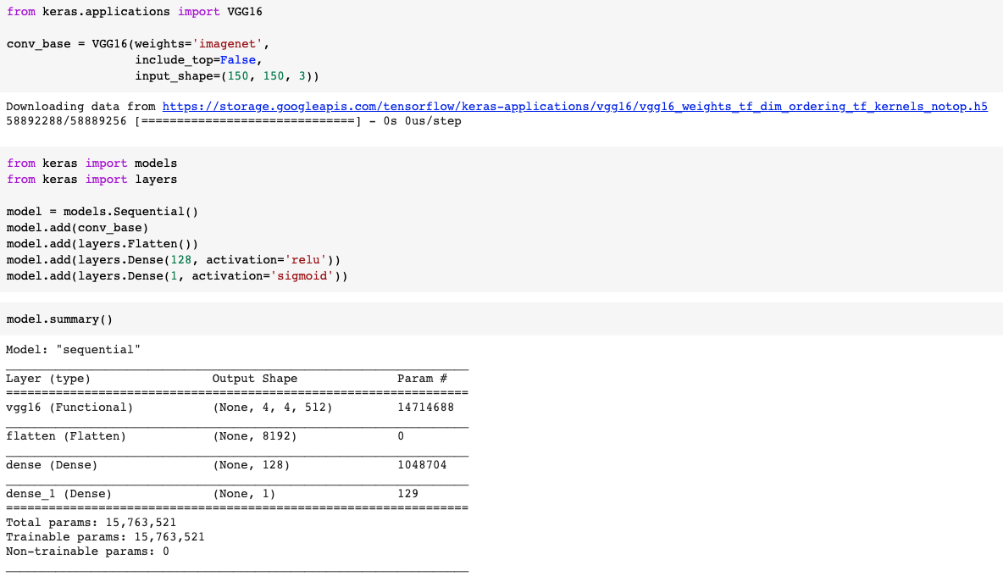
+ Transfer Learning & Fine Tuning

Slide 28
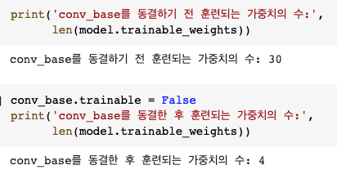
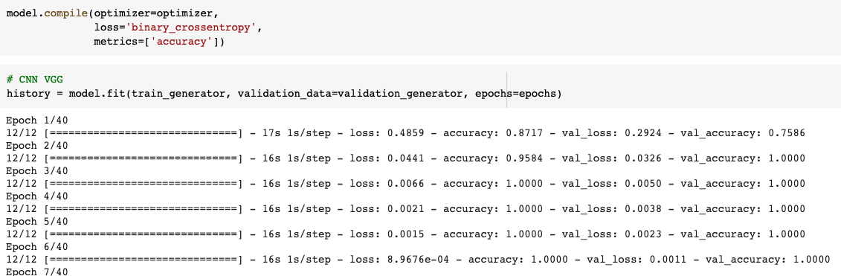
+ Transfer Learning & Fine Tuning
Freezing Layer : 뒤에 붙인 DNN만 가중치 업데이트

Slide 29
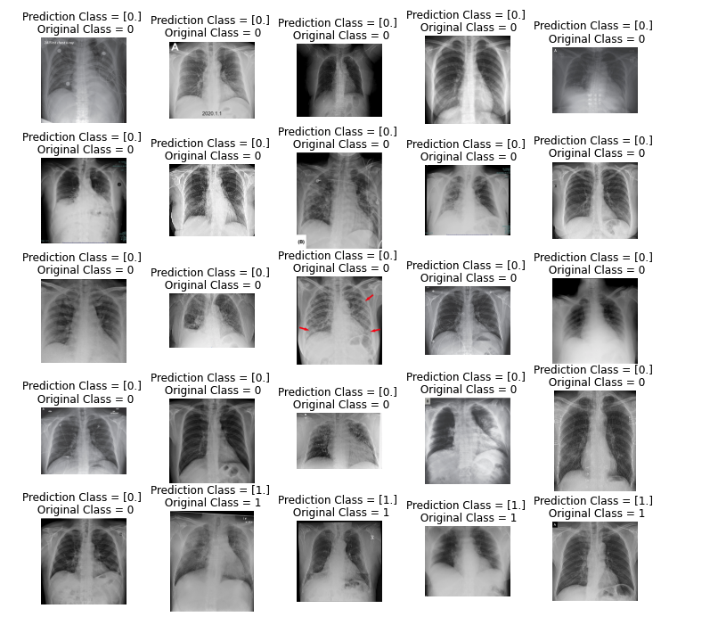
+ Transfer Learning & Fine Tuning

Slide 30
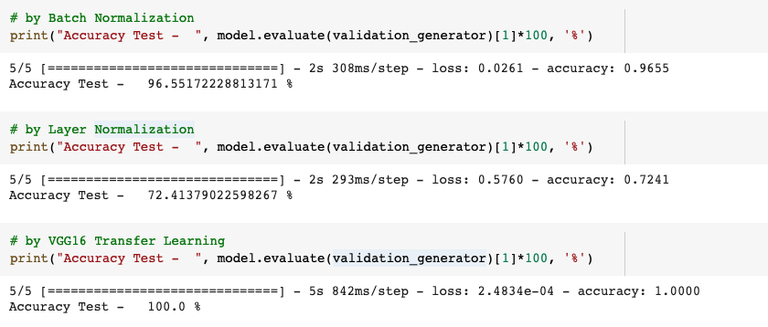
+ Transfer Learning & Fine Tuning

Slide 31
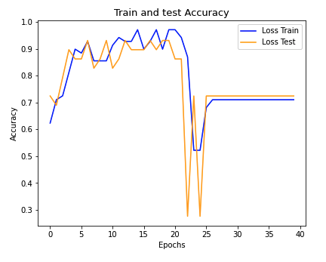
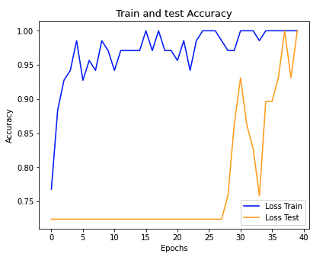
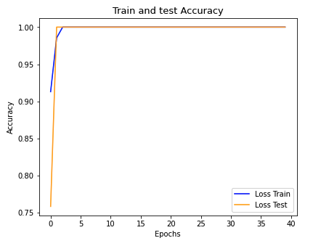
+ Transfer Learning & Fine Tuning
Layer Normalization Batch Normalization VGG16

Slide 32
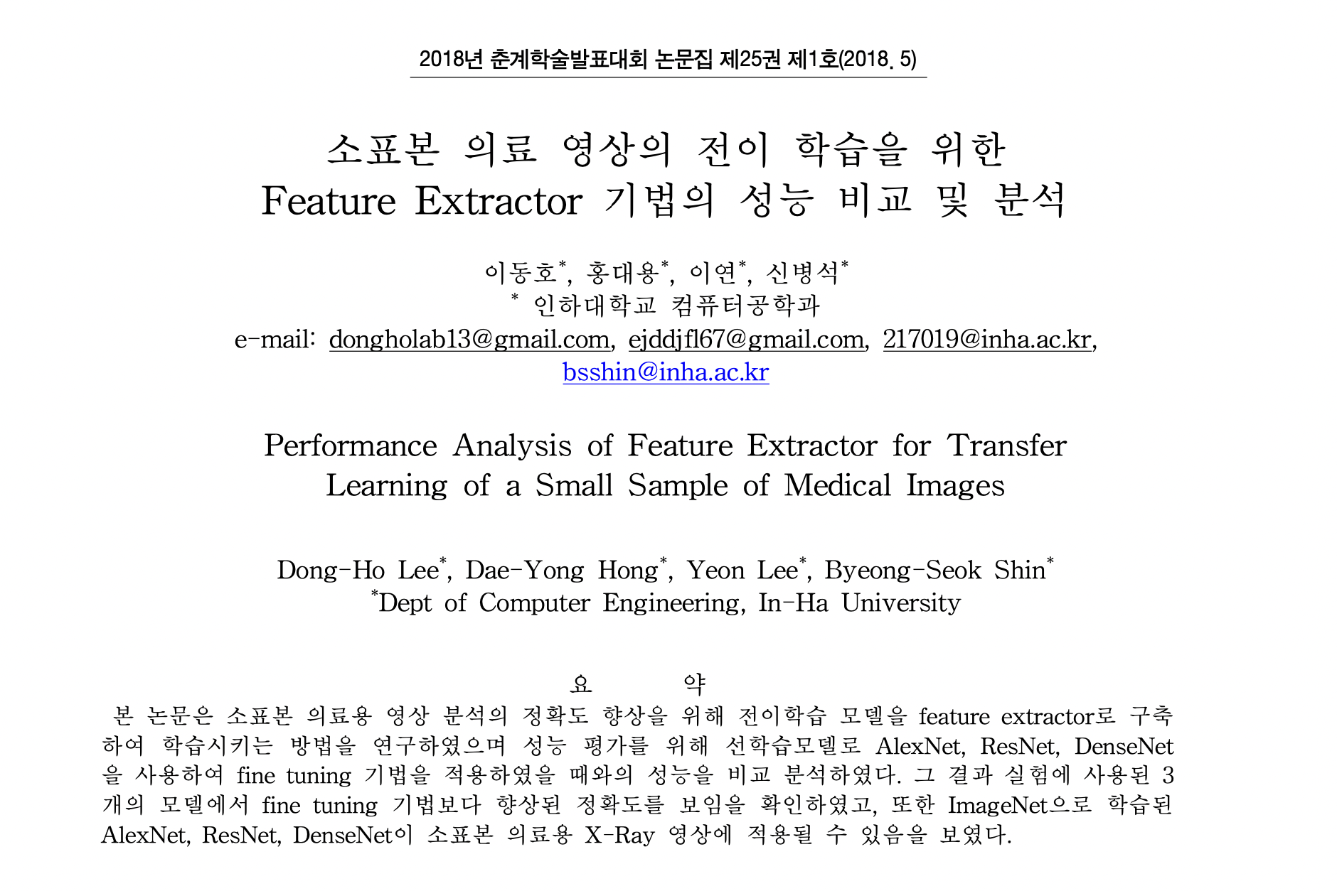
참고논문

Slide 33
Thank you QnA

